Slide 1


Superconducting gatemon qubit based on a proximitized 2D Electron Gas (2DEG)
By Lucas Casparis, Malcolm R. Connolly, Morten Kjaergaard, et al.
Presented by Thomas Kuo
National Sun Yat-Sen University (中山大學)
4/27/2020

Slide 2
Outline
Brief Recaps
Gatemon
Andreev Reflection
2DEG Gatemons
Experimental Demonstrations and Results
Future prospects
Contributions

Slide 3
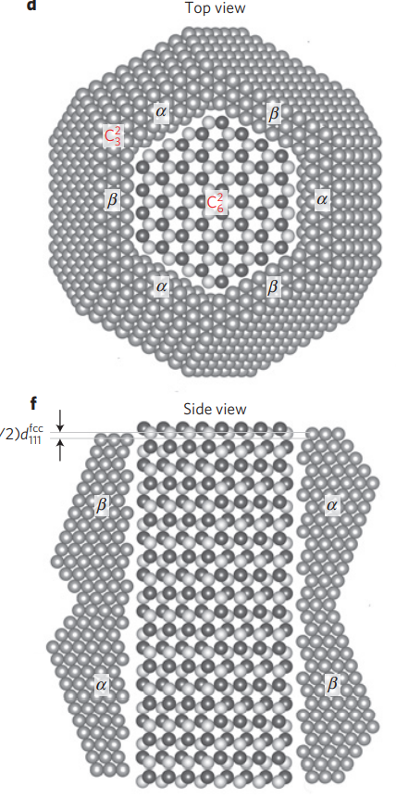
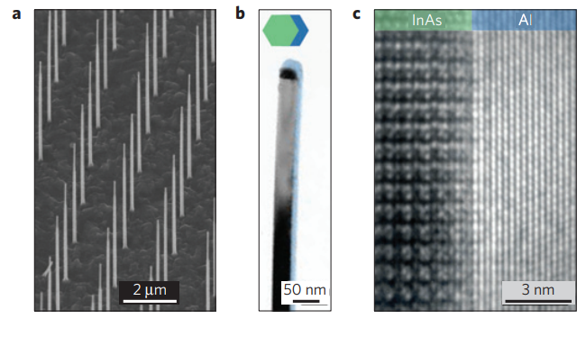
Gatemon qubit
Transmon variant
Superconductor - Semiconductor - Superconductor JJ
P. Krogstrup, et al, “Epitaxy of semiconductor–superconductor nanowires”, Nature Materials

Slide 4
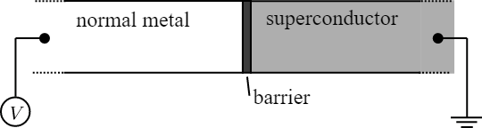
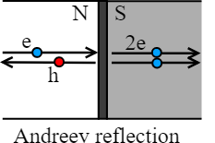
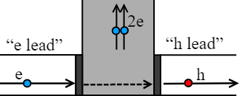
Andreev Reflection
The main mechanism for normal metal (N) - semiconductor (S) electron transport

Slide 5
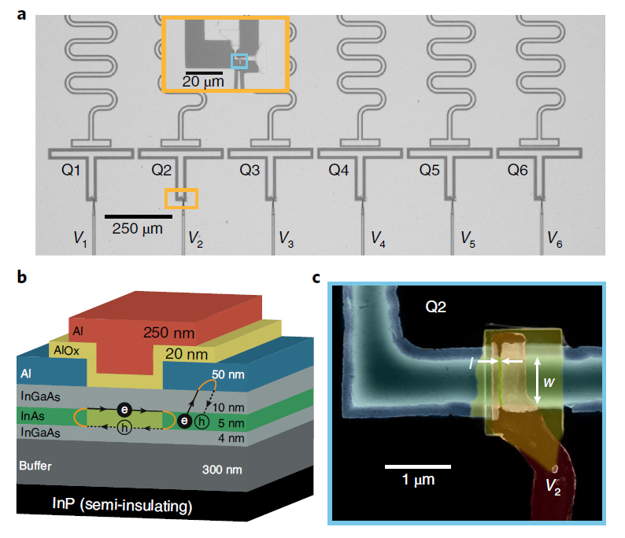
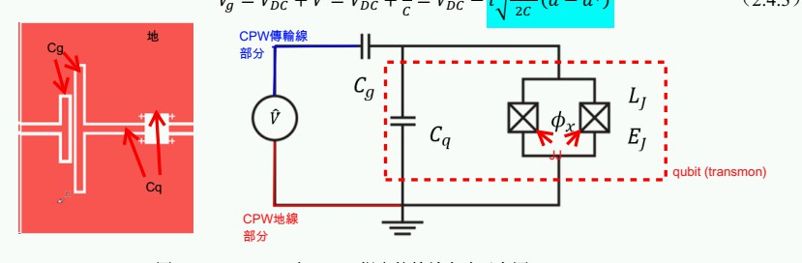
2DEG Gatemons

Slide 6
2DEG Gatemons

Slide 7
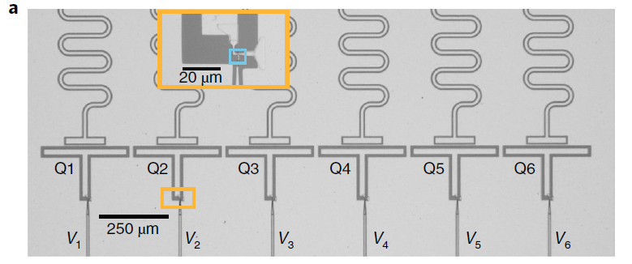
Experimental Demonstrations of 2DEG Gatemons
E_{f} measurement
Tuning qubit transition frequency
Single qubit rotation
Measure T₁ , T_{2,echo}
Estimate dielectric loss of the qubit capacitor
Two qubits swap operations

Slide 8



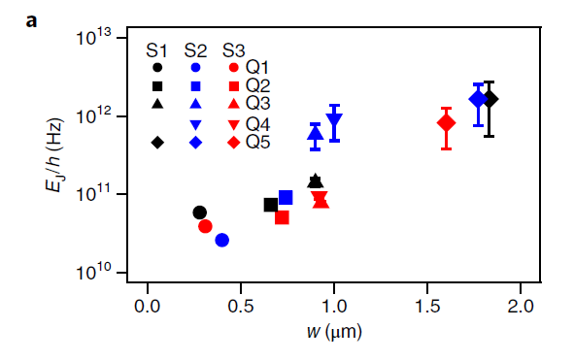
E_{f} measurement
Overview of E_{J} as a function of w for three devices, S1, S2 and S3, at zero gate voltage and < 50mK.

Slide 9
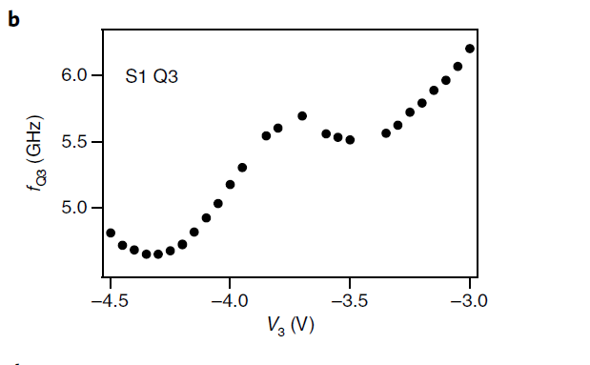
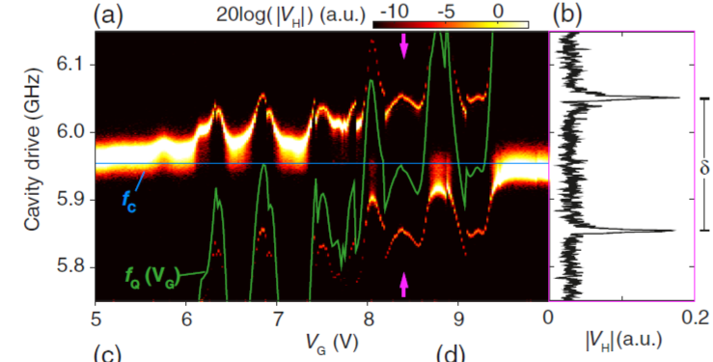
Tuning qubit transition frequency

Slide 10
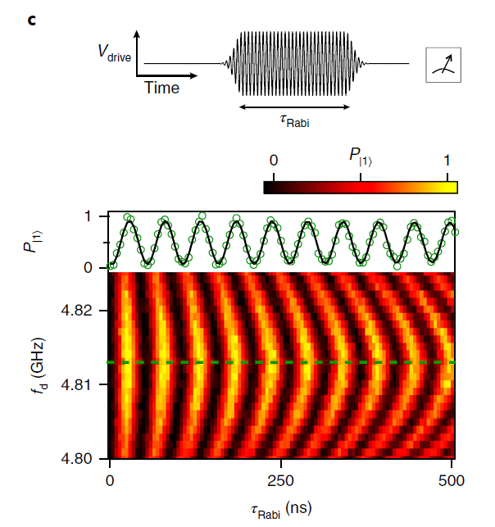
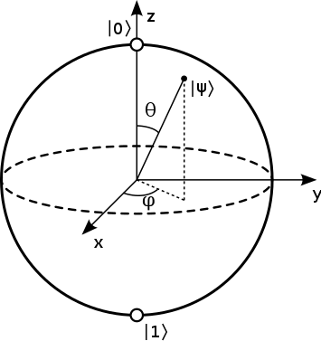
Rabi-oscillation measurement

Slide 11
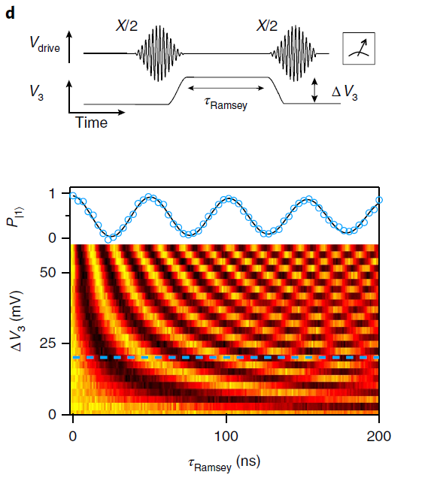

Slide 12
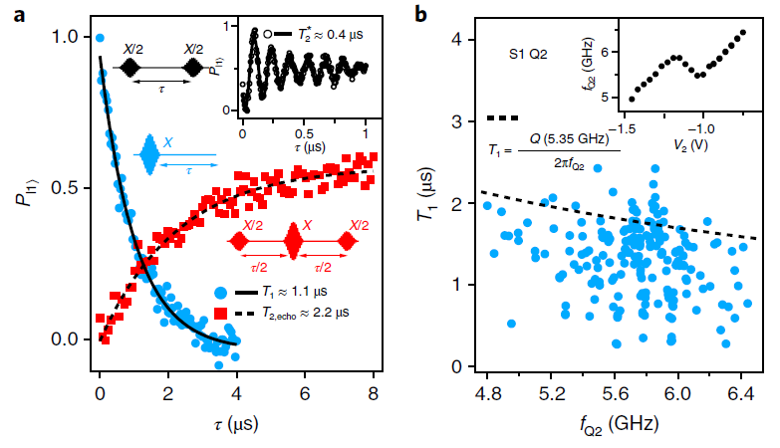
Measure relaxation time T1 , dephasing time T₂* , T_{2,echo}

Slide 13
Estimate dielectric loss of the qubit capacitor

Slide 14
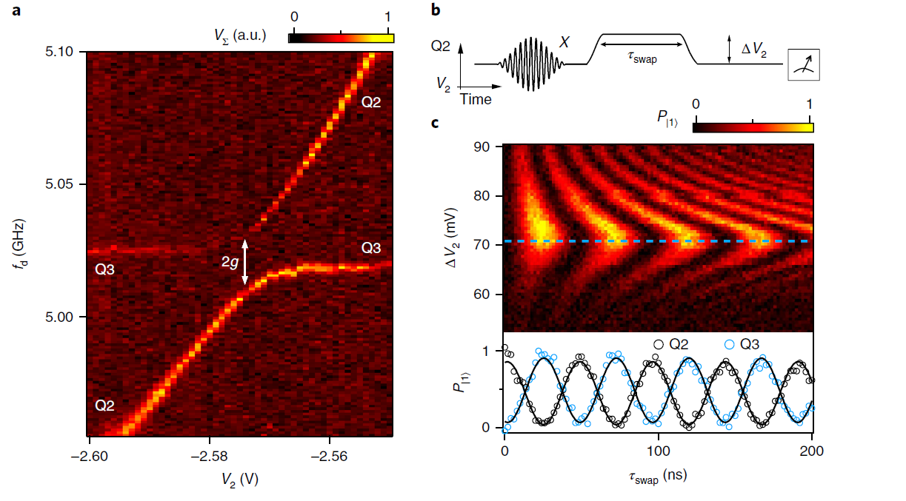
Perform excitation swap by qubit-qubit capacitively coupling

Slide 15
Contribution
New possibilities for highly integrated quantum processors
Through a combination of geometry and applied voltages, E_{f} can be tailored to simultaneously suit qubit and peripheral control circuits
A perfect quantum counterpart to semiconductor-based cryogenic classical control logic models. A first step towards realizing a scalable all-electric hybrid superconductor-semiconductor quantum processor.
Demonstrated planar semiconductor materials and superconducting microwave circuits are compatible technologies that can be readily integrated while they maintain quantum coherence.

